Slide 1

4 The People
Zainab Sirajo, Nailah Berube, Nick Bourne, Ayoub Osman, Tomaney Hendricks

Slide 2
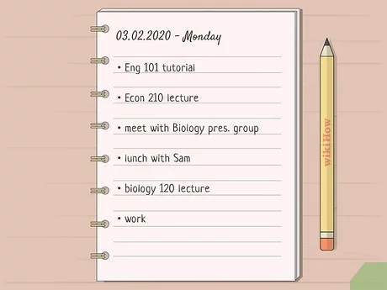
To-Do List 4 The People
A to-do list or task monitor system can be used by a variety of users.
The system can be used for personal or team productivity to help with time management.

Slide 3
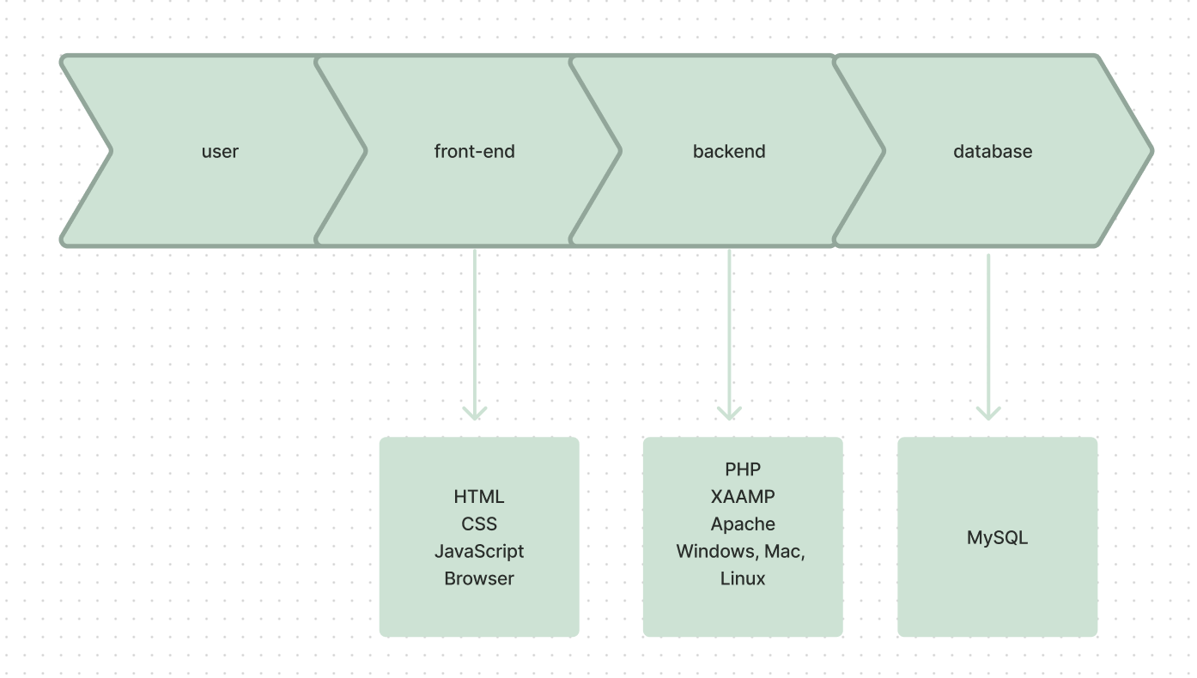
System Design

Slide 4




User Stories
Prioritization
Task Progression
Collaboration
Reminder/Calendar

Slide 5
Functional Requirements
Task Creation
Task Organization/Prioritization
Edit & Delete Tasks
Collaboration
Login

Slide 6
Non-Functional Requirements
User Interface Design
Code Maintainability
Storage
Accessibility
Load Test

Slide 7
Main Use Cases
Task Creation - A user should be able to create tasks and add tasks to a list. This will help the user accomplish whatever needed whether it be personal or work related.
Task Organization/Prioritization - A user should be able to organize tasks in order of prioritization so that they know what tasks need to be completed first. It can also help with time efficiency.

Slide 8
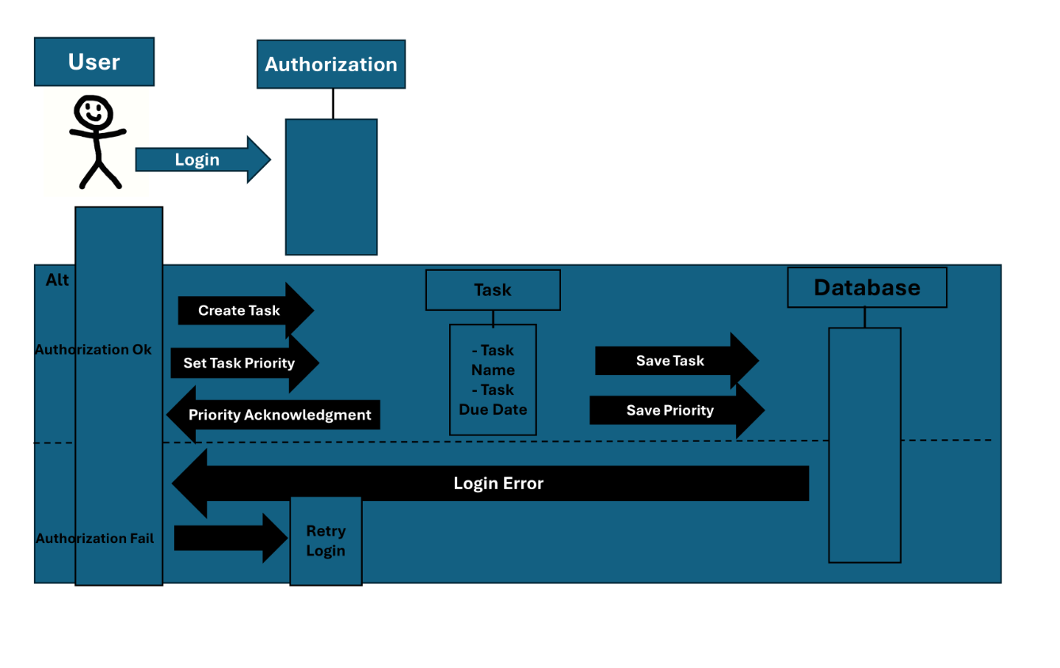
Sequence Diagram

Slide 9
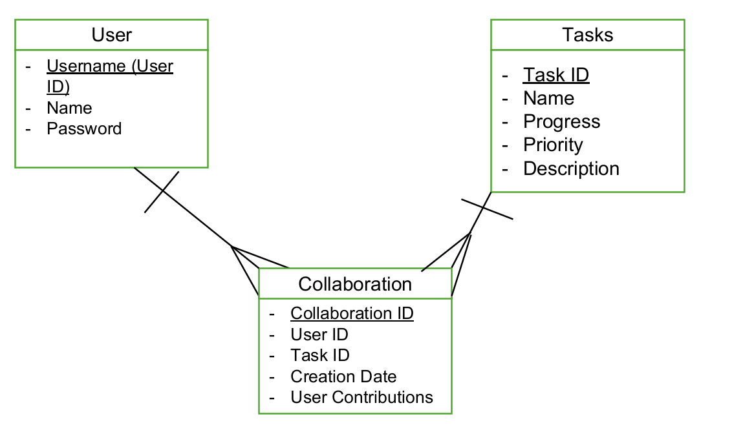
ERD

Slide 10
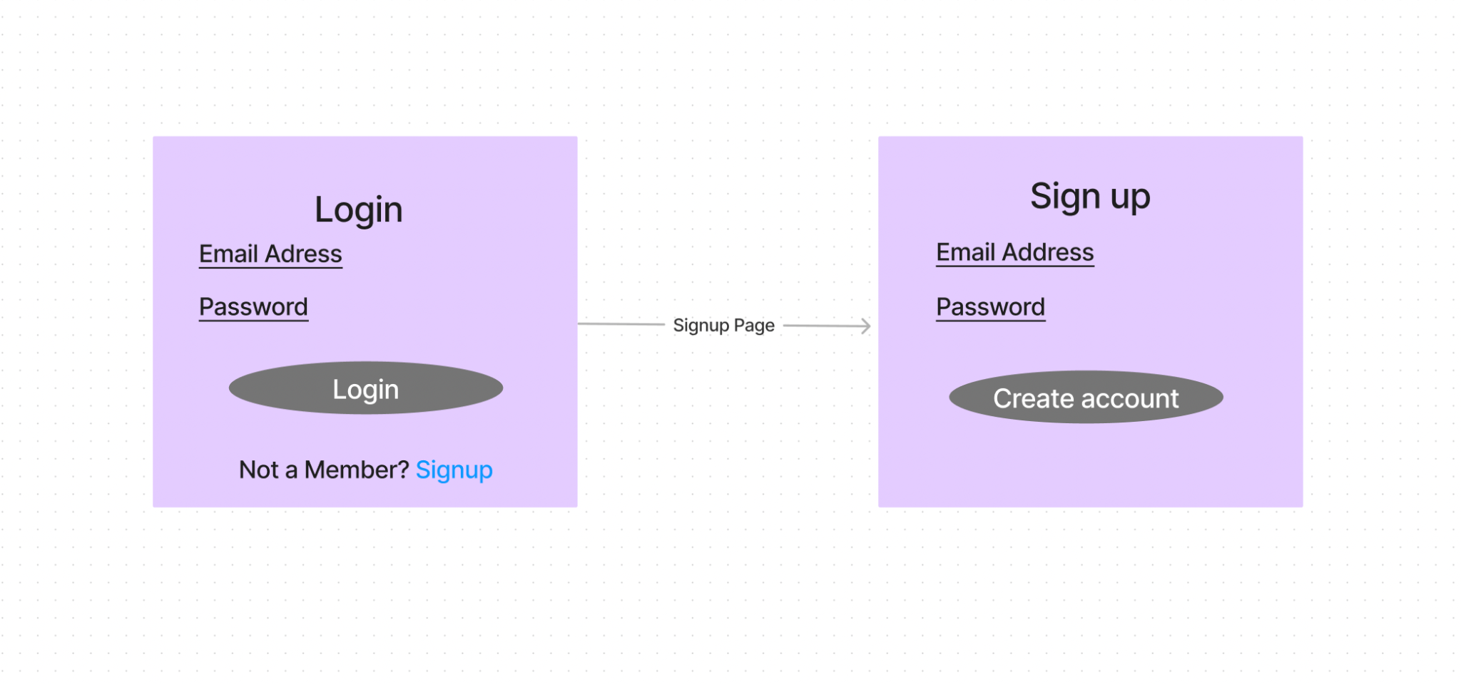
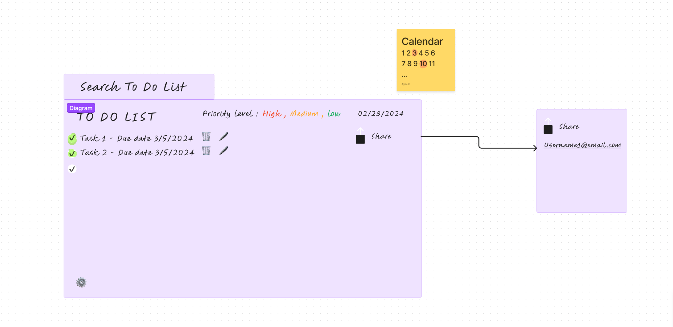

Slide 11
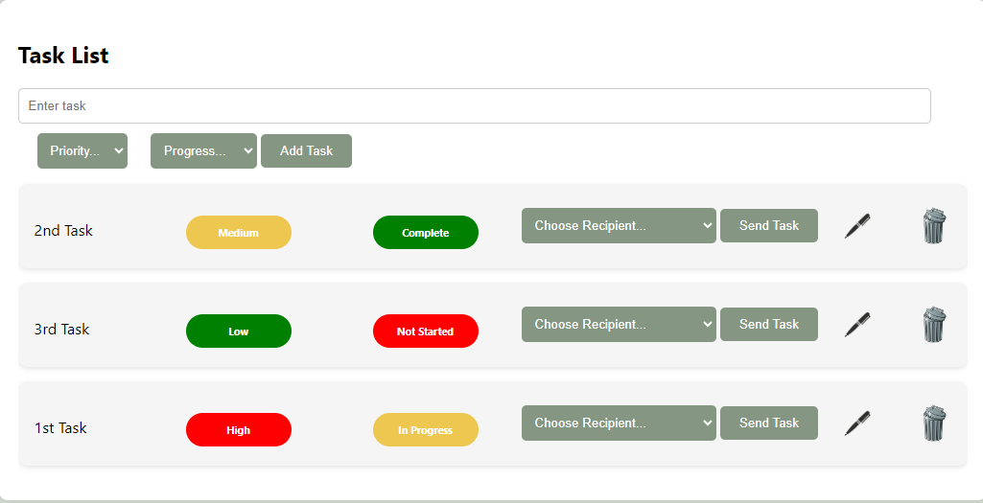
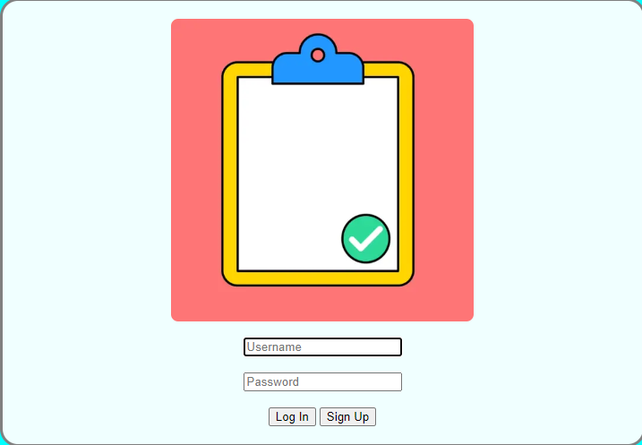

Slide 12
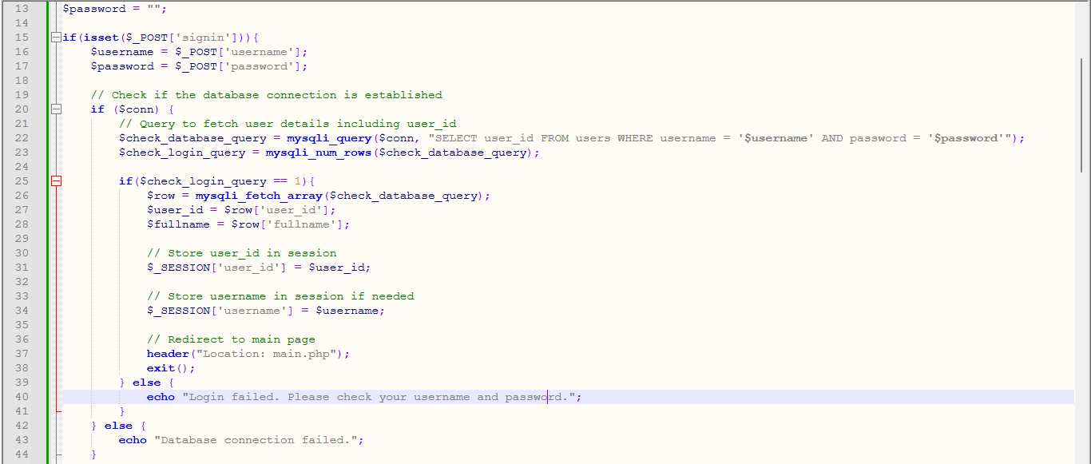
Sign up/Login Page

Slide 13
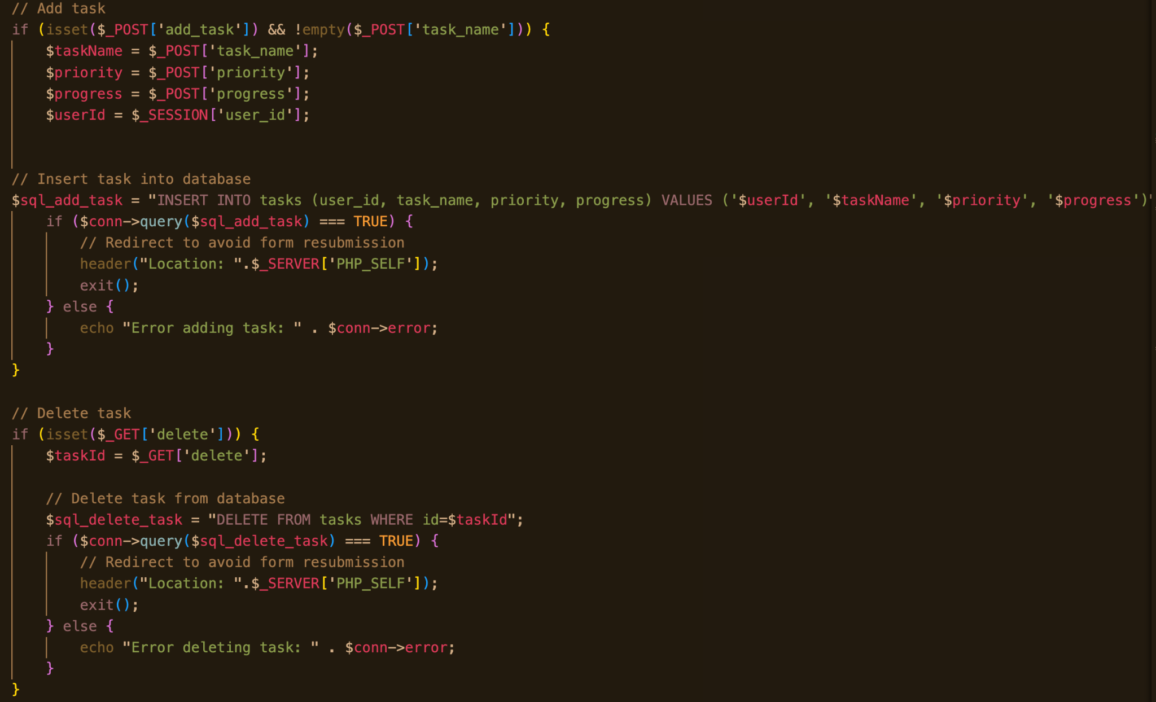
Dashboard
Task Overview: Today's Tasks, Overdue Tasks, Upcoming Tasks, Completed Tasks
Task Management: Add New Task Button, List of Task with Checkbox, Task Name, Due Date, Priority
Task Details: Task Name, Due Date, Priority Level, Notes, Edit and Delete Options
Reminders: Set Reminders for Tasks
Collaboration: Share Tasks/Projects with other users
Log Out

Slide 14
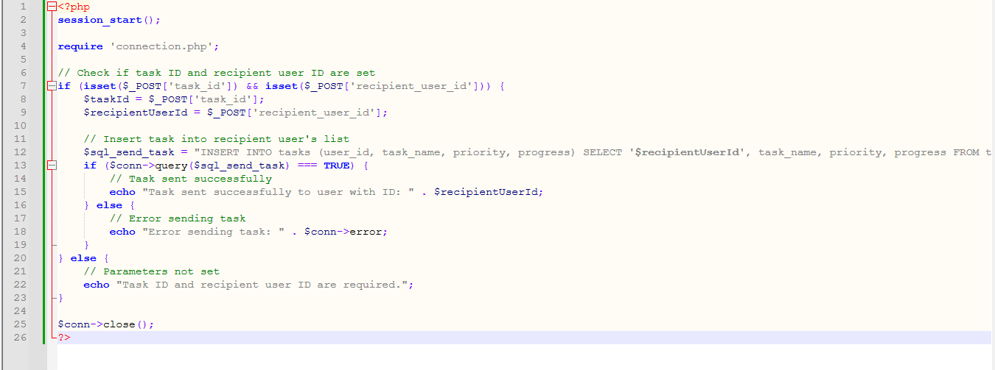
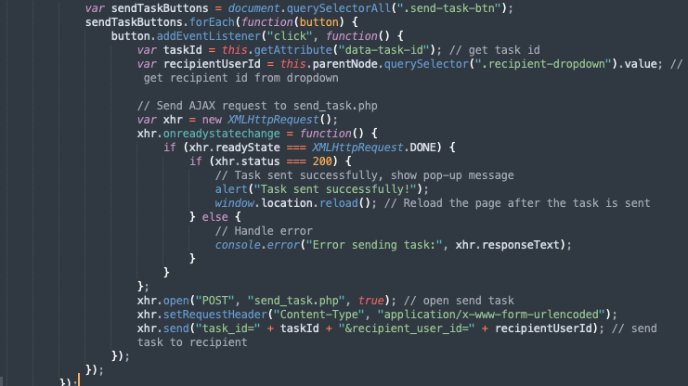
JavaScript Functionality

Slide 15
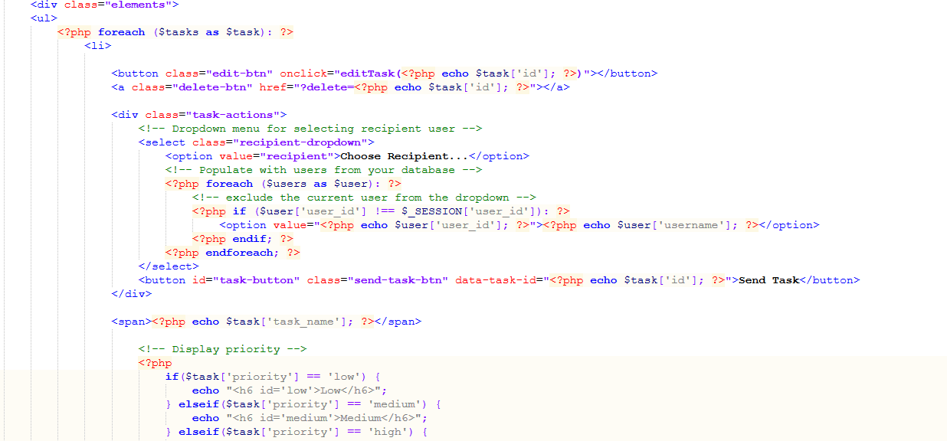
Dashboard Continued…

Slide 16
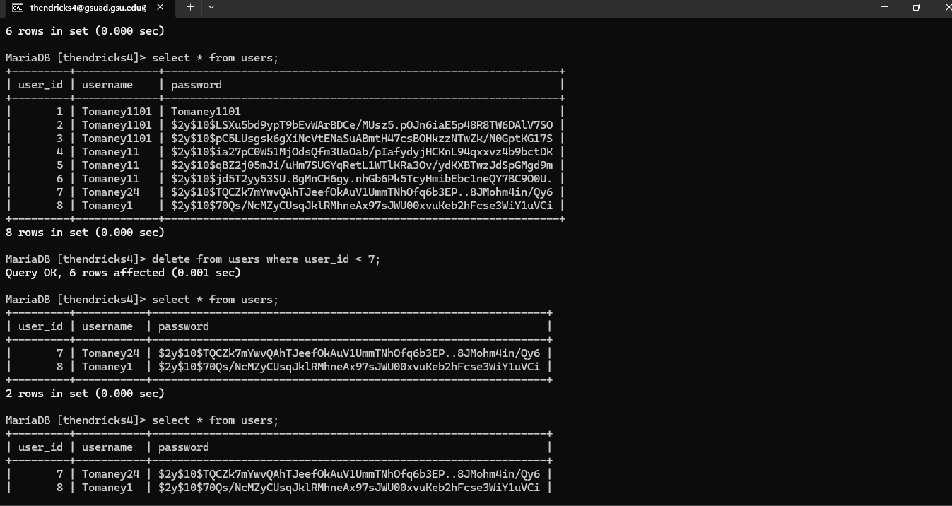

Slide 17
Demo

Slide 18
Project Goal & Experience
Goal: Develop a user-friendly and efficient web application that helps users manage their tasks effectively through a to-do list interface.
Deliverables: Task management, Intuitive Interface, Collaboration Features, Reminder System
Experience: Bugs , difficulties

